Slide 1

[Tablet Test Launch Findings]

Slide 2
Summary
Sauce and Spoon rolled out its tablet test launch in two of its locations: North and Downtown. The tablets were installed only in the bar sections for the time being. For the test launch, 50 guests were invited to dine in our restaurants. We asked the customers to engage with the newly implemented tablets, as if they were participating in a typical restaurant experience. The customers were sent a digital survey after their experience ended.

Slide 3
Overview
The team wanted to measure the effectiveness of the tablets in terms of customer satisfaction, ease of use, and productivity enhancements. Indicators used to measure were the overall dining experience, clarity in the instructions from waiters on how to use the tablet, tablet navigation, checkout process and absence of technical glitches. We also wanted to measure how well the tablets aided in increasing the appetizers sales and thereby increasing our profit margin.

Slide 4
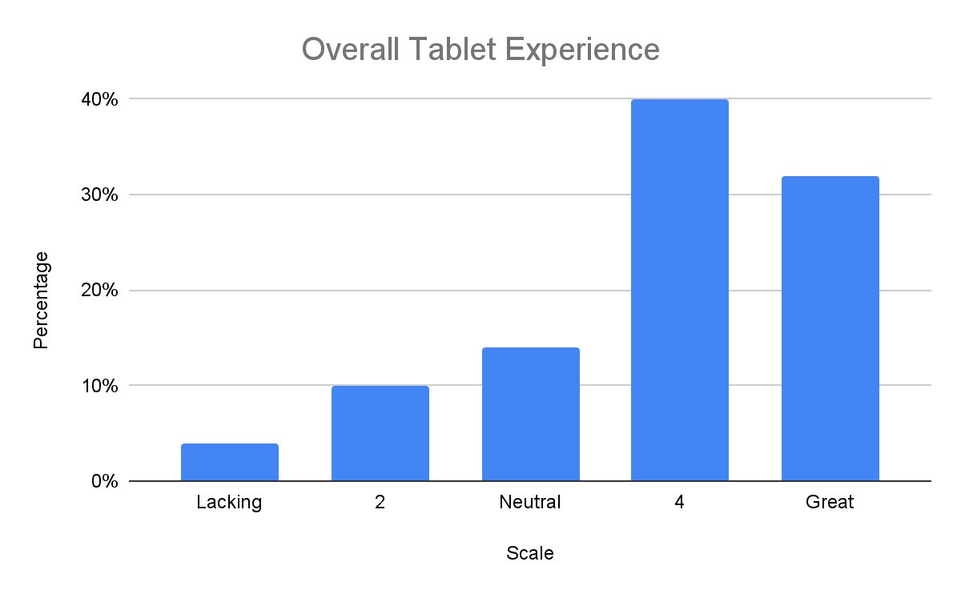
Findings
A sum of 72%(rating of 4 and 5) of customers stated that they were satisfied with the overall experience with the tablet.

Slide 5
Next Steps
From the survey, 56% of the customers stated that they waited nearly 20 mins to receive their order which goes against our goal of 12 - 15 mins as an ideal wait time Also 54% of the customers stated that they had to wait 15+ mins to be seated at the table against our goal of less than 10 mins wait time. Both of these findings are related to the shortage of kitchen staff. As the use of tablets results in a higher volume of orders, we will need to hire more kitchen staff(BOH) to handle the increase in orders.

Slide 6
Next Steps
12% of the customers have stated that they experienced technical glitches while operating the tablets against our goal of 5% complaints per week. The issues were encountered either while ordering or during the checkout process. We will check with the IT personnel to determine if the glitches are caused due to software or hardware problems and find solutions to fix it.

